Slide 2
Attack & Detection in Windows Environments

Slide 3



WHOAMI /ALL
Chief Technical Architect – Microsoft Security
Most Valuable Professional
Microsoft Certified Trainer
Giac Certified Penetration Tester
Microsoft infrastructure and security expert (security researcher)
15 years+ with Microsoft technology
http://oddvar.moe
I like memes and gifs
@oddvarmoe

Slide 4

My favorite Hollywood hack scene

Slide 5
My goal with this session
Give examples on real world attacks
Show my favorite external attacks
NTLM hash
Phishing mail
OWA rules
Show Internal reconnaissance
Counter measures and detection methods
Think Assume Breach!
@oddvarmoe

Slide 6



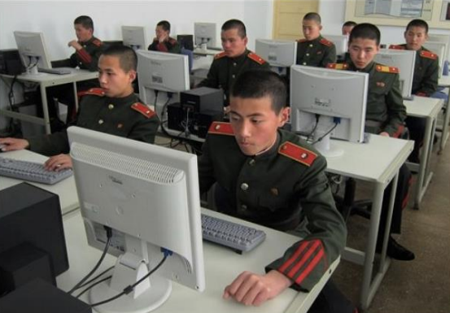


Who is attacking?
2 types of attackers
VISIBLE ATTACKERS
INVISIBLE ATTACKERS
@oddvarmoe

Slide 7
Attack methodology
Open Source Intelligence
Homepage – metadata
Social medias
Password dumps
Google dorks
Shodan
Social engineering and Spear Phishing
Drive By Attacks
Brute force / Wordlist
Exploiting External servers
Alternate attack paths
3.party
@oddvarmoe

Slide 8
Attackers goal
Steal Intellectual property
Abuse infrastructure
Strategic goal
Disclose
Great example: Phineas Fisher -Hacking team - 2015
http://pastebin.com/0SNSvyjJ
https://www.youtube.com/watch?v=BpyCl1Qm6Xs
@oddvarmoe

Slide 9
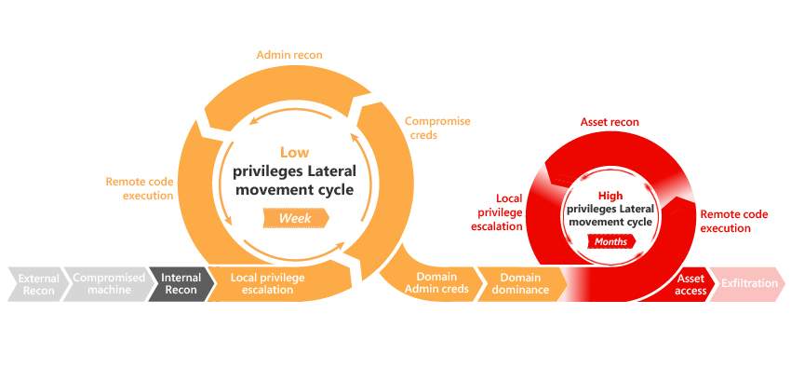
Attack kill chain
Average 140 days

Slide 10
Open source intelligence Disclaimer: Accounts used in the following slides are just examples. Its illegal to use this information to logon.
@oddvarmoe

Slide 11
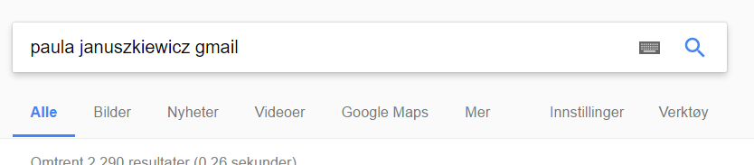
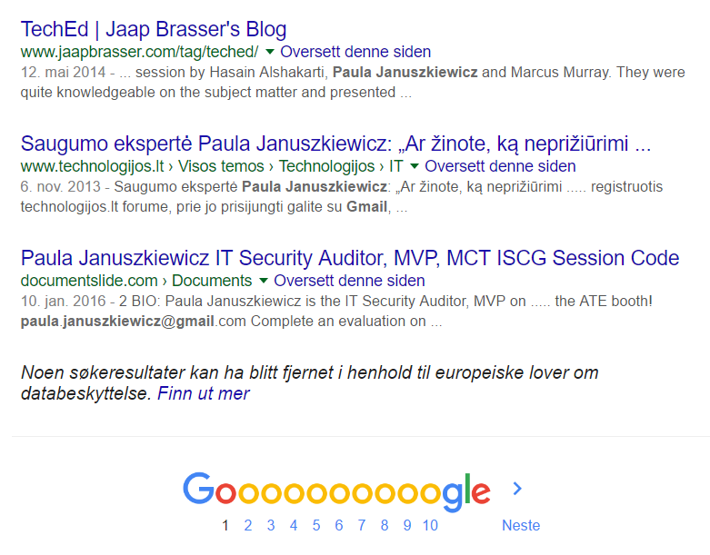
@oddvarmoe

Slide 12
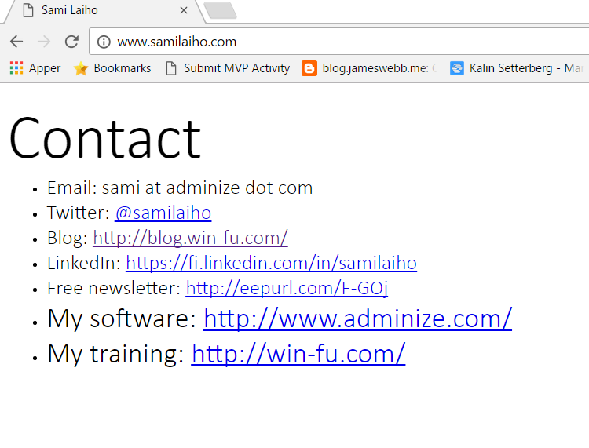
@oddvarmoe

Slide 13
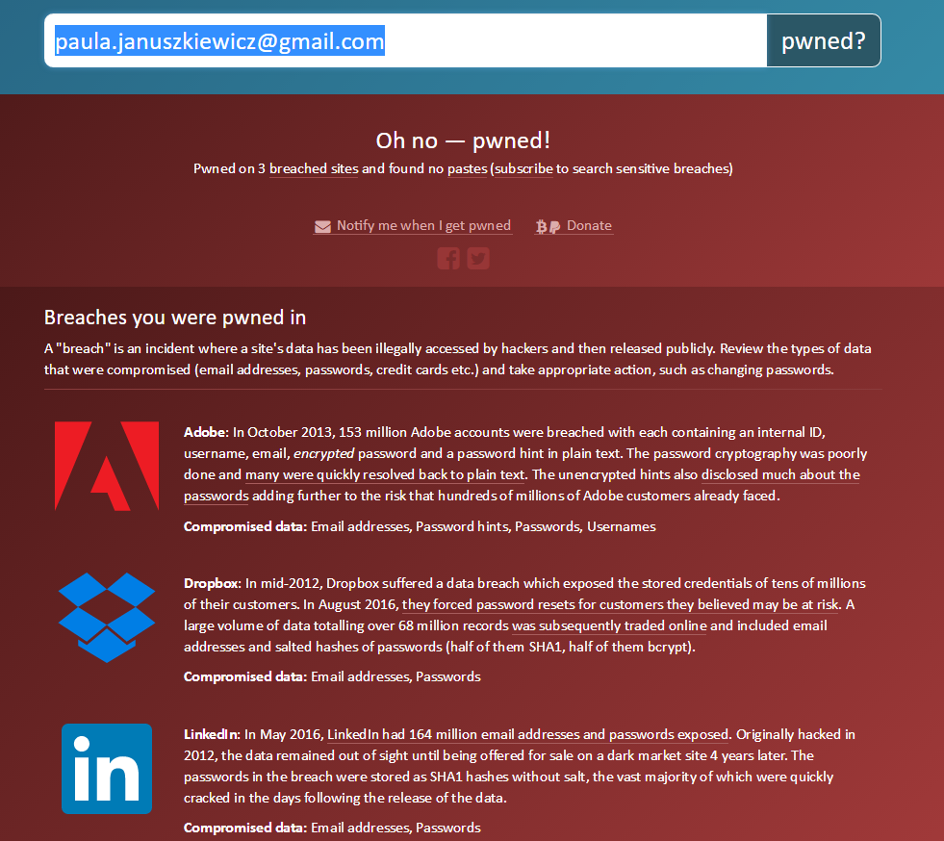
@oddvarmoe

Slide 14
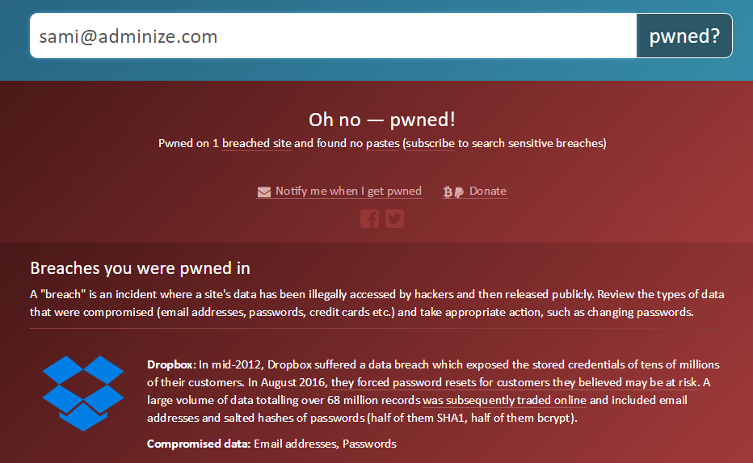
@oddvarmoe

Slide 15
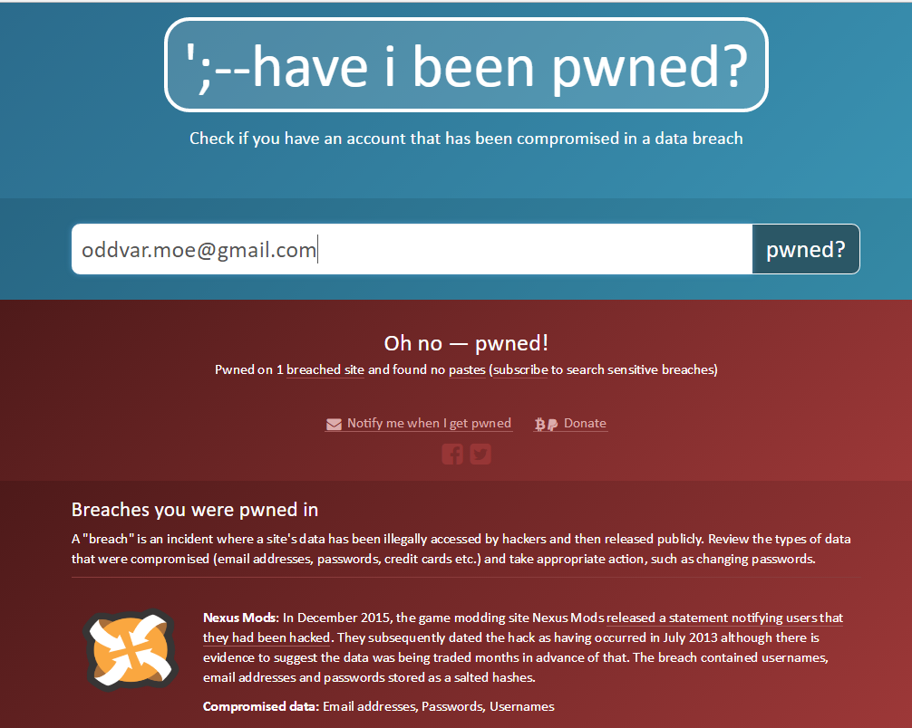
@oddvarmoe

Slide 16
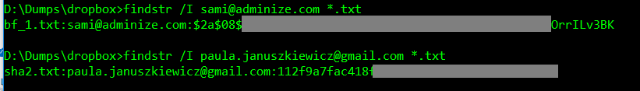
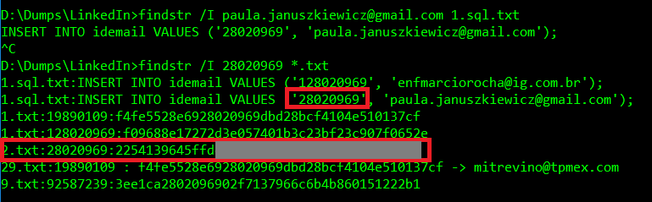
@oddvarmoe

Slide 17
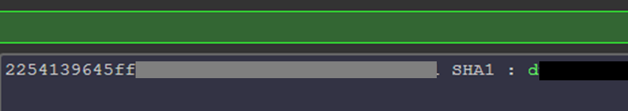
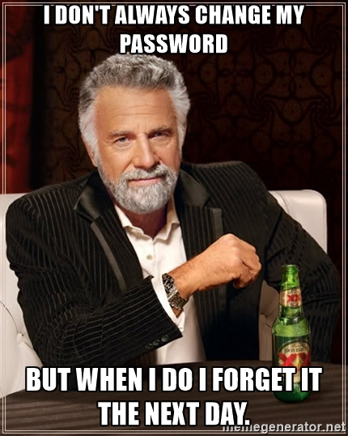
http://haveibeenpwned.com
@oddvarmoe

Slide 18
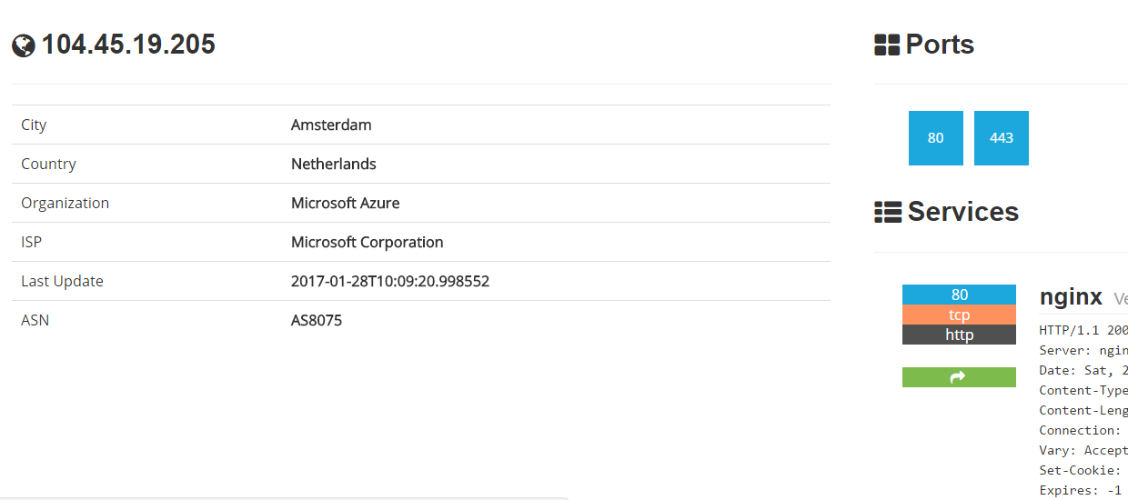
Other open source intelligence resources SHODAN.IO

Slide 19
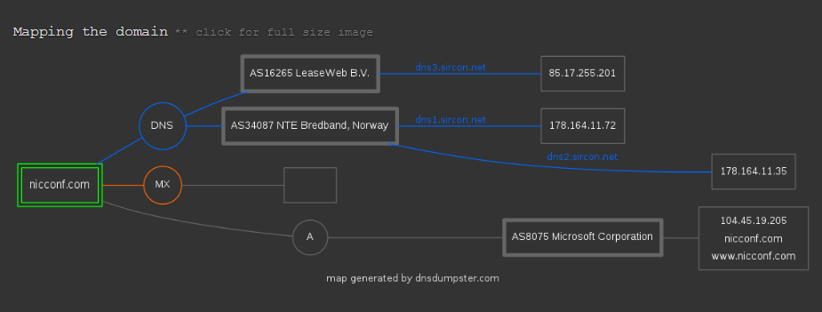
Other open source intelligence resources DNSDUMPSTER.COM
@oddvarmoe

Slide 20
Other open source intelligence resources Google and pastebin
"site:pastebin.com | site:paste2.org | site:paste.bradleygill.com | site:pastie.org | site:dpaste.com | site:paste.pocoo.org | site:pastie.textmate.org | site:slexy.org" intext:domainame.com
@oddvarmoe

Slide 21
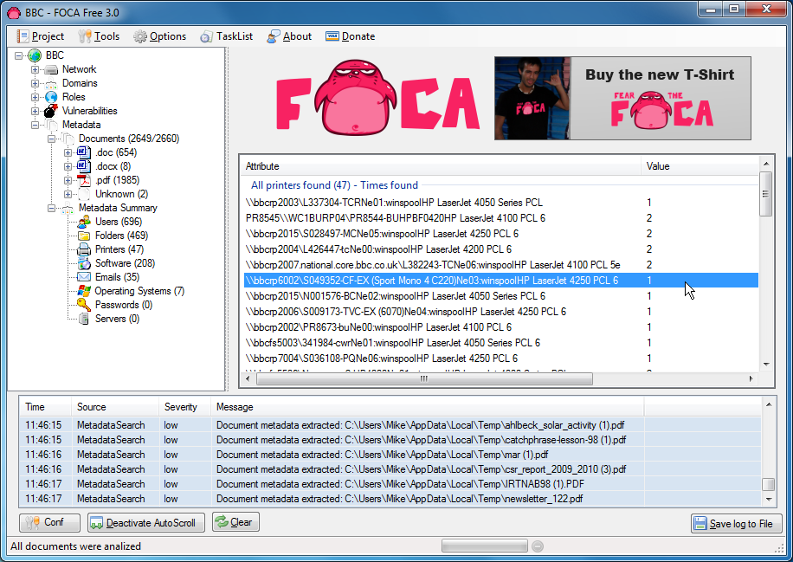
Other open source intelligence resources SCRAPING HOMEPAGE - FOCA
@oddvarmoe

Slide 22
Attack demos
Gain access:
NTLM hash from picture
Sending attachments
Using OWA
Escalate privileges:
Scan for local admin rights on other machines
Place LNK on share
Look through shares
Persistence
@oddvarmoe

Slide 23
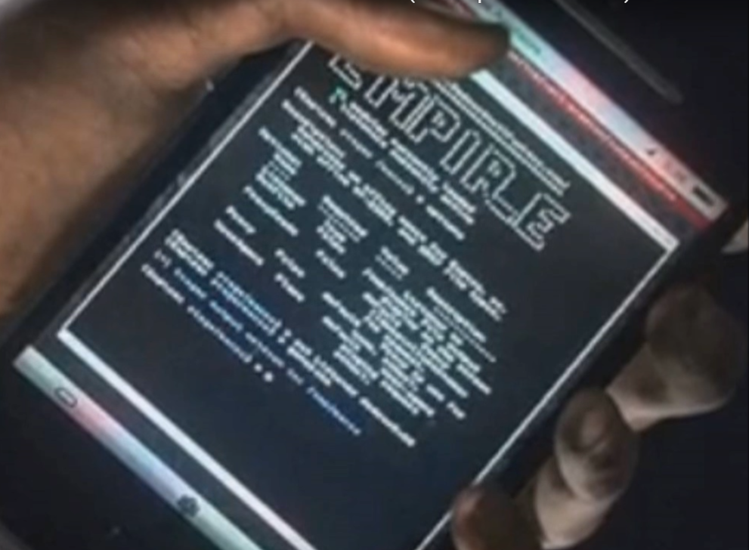
Red Team Tool – Powershell Empire
Shoutout to
Will Schroeder - @harmj0y
Justin Warner - @sixdub
Matt Nelson - @enigma0x3
www.powershellempire.com
@oddvarmoe

Slide 24
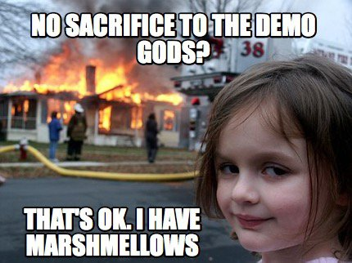
DEMO – Gaining Access
@oddvarmoe
Notes:
23min hit

Slide 25
Preventing these attacks
OWA – use MFA
Attachments on mail
Enable extra protection in GPO
https://blogs.technet.microsoft.com/mmpc/2016/03/22/new-feature-in-office-2016-can-block-macros-and-help-prevent-infection/
AppLocker/Device Guard
Lock down shares
Local admin
Client to client communication
Make internet great again and block 445
Net cease https://gallery.technet.microsoft.com/Net-Cease-Blocking-Net-1e8dcb5b
Test your security – You test your backup don’t you?
@oddvarmoe

Slide 26
Detecting the attacks
Windows Defender ATP
Windows Advanced Threat Analytics
User Behavior
Exchange Online ATP
Do a hunt
Cimsweep is nice: https://github.com/PowerShellMafia/CimSweep
Tripwire or Sysmon
More logging! https://adsecurity.org/?p=3377
IDS / IPS
SIEM / OMS
@oddvarmoe

Slide 27
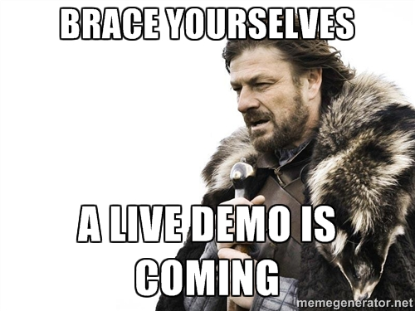
DEMO – Detection
@oddvarmoe

Slide 28
SUMMARY
Assume breach
Harden your stuff
Get detection going
Test your security
Educate end users
Do regular hunting
@oddvarmoe

Slide 29

THANKS FOR YOUR TIME
http://oddvar.moe

Slide 30

Don’t be like Trump
Give me a green card when you exit

